Slide 1
mi·cro·pro·duc·tiv·i·ty /ˈmīkrō prōˌdəkˈtivətē/ noun
Jaime Teevan, Microsoft Research, @jteevan

Slide 2
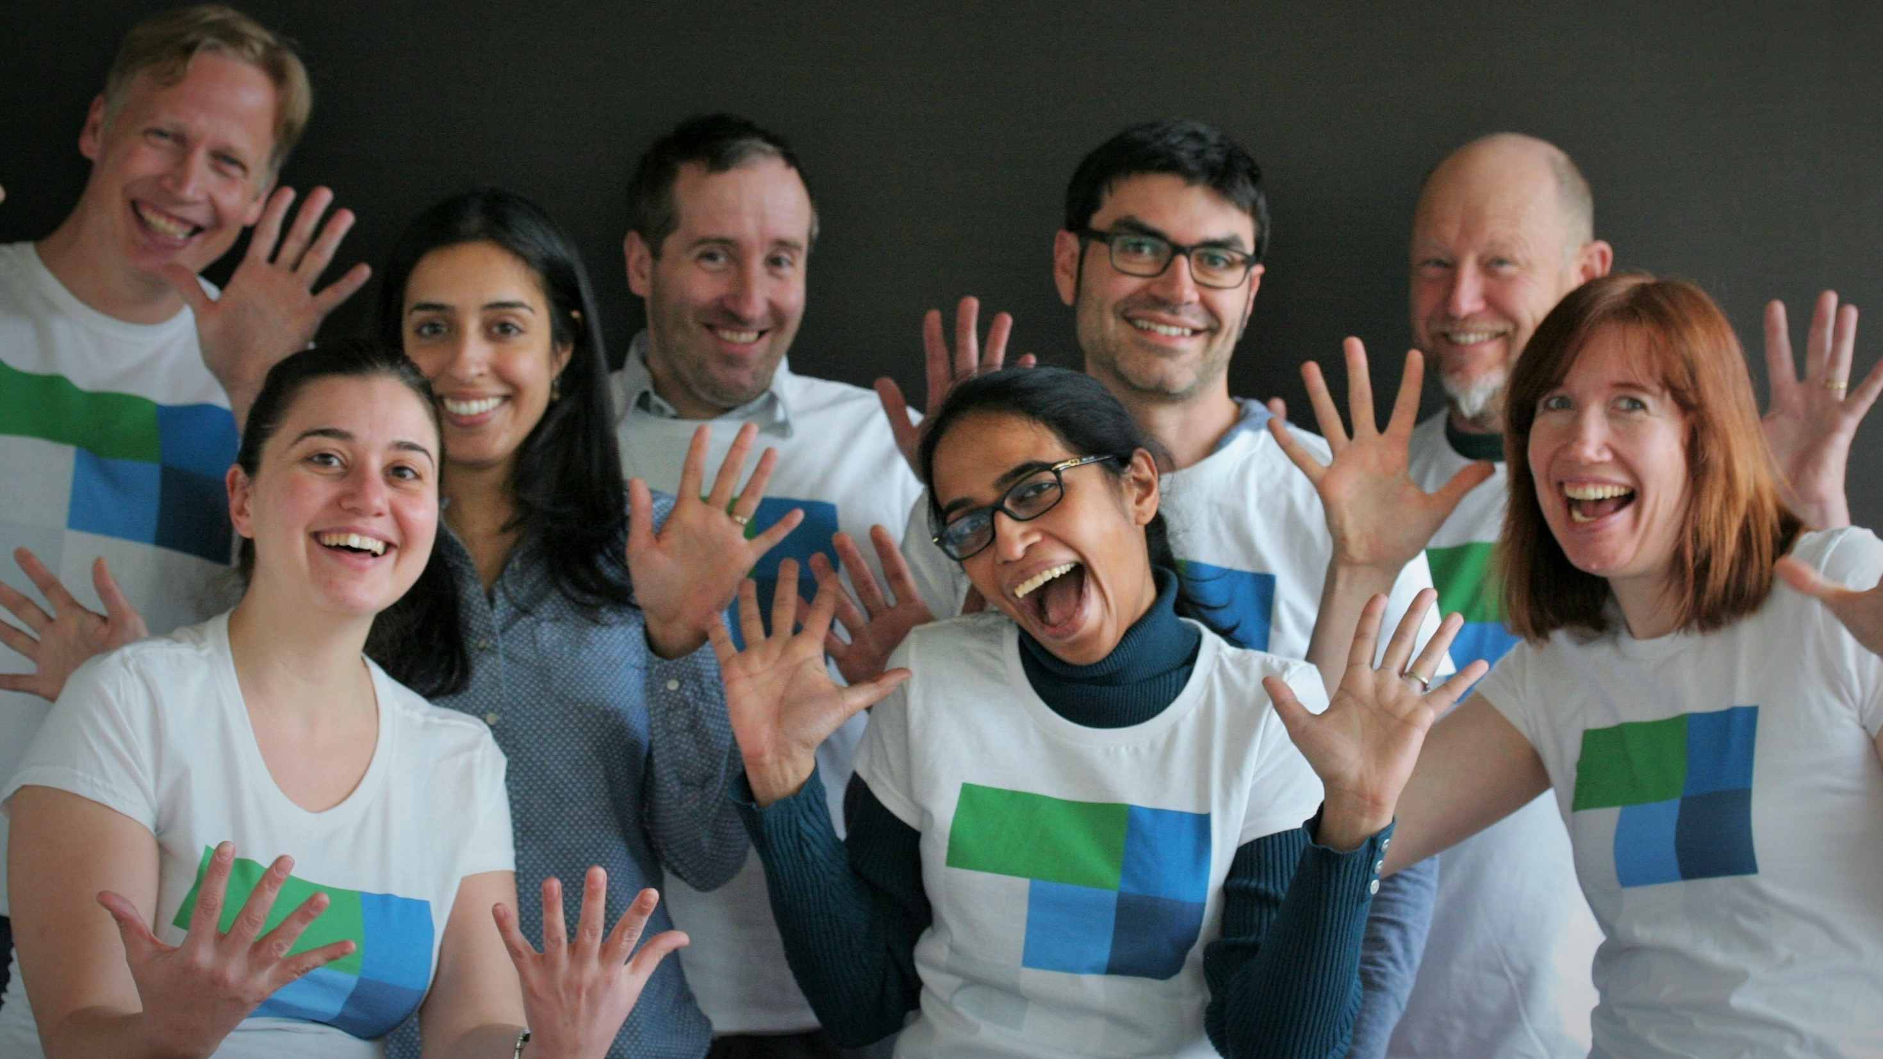
Notes:
Pictured: Darren Gehring, Saleema Amershi, Rob Gruen, Dan Liebling, Shane Williams (top), Ece Kamar, Shamsi Iqbal, Jaime Teevan (bottom)
Additional team members: Kristina Toutanova, Andres Monroy-Hernandez, Justin Cranshaw

Slide 3

Notes:
Although we think complex information work requires a large, uninterrupted chunk of time to complete, we almost never actually have a solid block time in which to get things done.
Research shows it takes 25 minutes to reach full productivity after an interruption, yet we are interrupted every 11 minutes. Never working at full productivity.
Even without external interruptions, our focus is fragmented.
We look at any given desktop window an average of only 20 seconds, constantly self-interrupting to check email or Facebook.
We also try to complete multiple tasks at once, despite the fact that we all know multitasking produces worse outcomes than doing tasks serially.
Our tendency to be easily distracted kept our hunter and gatherer ancestors alive when they needed to attend to potential predators.
But now, in the safety of our offices, it is amazing we get anything done.
Many of the chunks of time we have in a day are too short to bother trying to use productively.
Think of the time you spend waiting for a meeting to start, riding in an elevator, or standing in line.
Yet these micromoments add up.
People spend 200 million minutes a day on Angry Birds alone.
If we could leverage the small mobile bursts of effort that Angry Birds players currently spend killing time, it would only take 18 days to release the equivalent of Microsoft Office.

Slide 4
mi·cro·pro·duc·tiv·i·ty /ˈmīkrō prōˌdəkˈtivətē/ noun
The transformation of large productivity tasks into a set of smaller microtasks that can be completed individually in short bursts of time with limited context.
Notes:
We try to defrag our time by booking meetings with ourselves, turning off our phones, and taking email vacations. But there is another way.
Rather than fighting our ancient nature and modern distractions by changing how we work, we can embrace fragmentation by changing our tasks to fit the way we actually do work.
We call this microproductivity, in which large productivity tasks are broken down into a series of smaller microtasks that can each be completed individually.
This is already what any pop-time management book suggests: Break your task down, focus on the next actionable item.
But because we now have the ability to algorithmically support task decomposition, we can break tasks into much smaller pieces than previously imaginable.
We believe this will fundamentally change how we work by increasing our personal productivity. It also makes it easy to share the aspects of a task that don’t require our unique insight with colleagues, paid crowd workers, or even automated processes.

Slide 5
Key Aspects of Microproductivity
Task Structure – Break tasks into microtasks
What we know: Examples of many complex tasks can be broken down
Still needed: What tasks can be broken down? How to capture context?
Task Completion – Make it easy to do microtasks
What we know: Microtasking is easier, especially when mobile
Still needed: When to break tasks down? How to prioritize microtasks?
Task Sharing – Get microtasks to the right person
What we know: Reduce collaboration overhead with colleagues, crowd
Still needed: Who is the best person to do a microtask?
Task Automation – Learn microtasks via hybrid intelligence
What we know: Possible to incorporate automation into workflows
Still needed: When can AI systems benefit from human input?
Notes:
Workflow design is a key aspect of microproductivity
There are a number of interesting existing workflows being used for crowdsourcing – itinerary planning, organizing content, etc.
Quality control is important aspect of workflow design, as is context transfer
As the library of workflows develop, surfacing the right workflow becomes a challenge
User generated as a first pass – even can be seen as a microtask in itself
Suggest the best workflows given context
Many of the microtasks extracted from a task require the task owner to complete them
because most personal information tasks require personal knowledge, expertise.
However, not all pieces require personal knowledge.
We can use this to incorporate others in the process.
Share tasks with
Collaborators
Crowd
Automated processes
Intentional trade-off of effort, quality, cost, privacy
The crowd within – other people sometimes provide useful input you can’t get yourself, but can simulate with intentional changes in context
Integrate automation in a way where it doesn’t have to be perfect
Learn from data to automate better – and to personalize
Collect data for learning

Slide 6
task structure – break tasks into microtasks
We already know how to break many common complex tasks down into a series of small microtasks that each individually require limited time, commitment, and context.
Notes:
Our team is looking at writing as a model productivity task.
Why?
Requires fundamental but varied skills (reading, analysis, reasoning, communication). Through writing, people solidify concepts that were previously hazy, challenge and transform existing knowledge, and construct entirely new models of reality. As such, provides a valuable lens through which to understand and explore a range of problems related to information work.
Hard to decompose. Many people balk at the idea that we might be able to create a coherent narrative in short bursts of time with limited attention.
Hard to outsource. Needs your unique knowledge.
Hard to do! We could all use some help here.

Slide 7
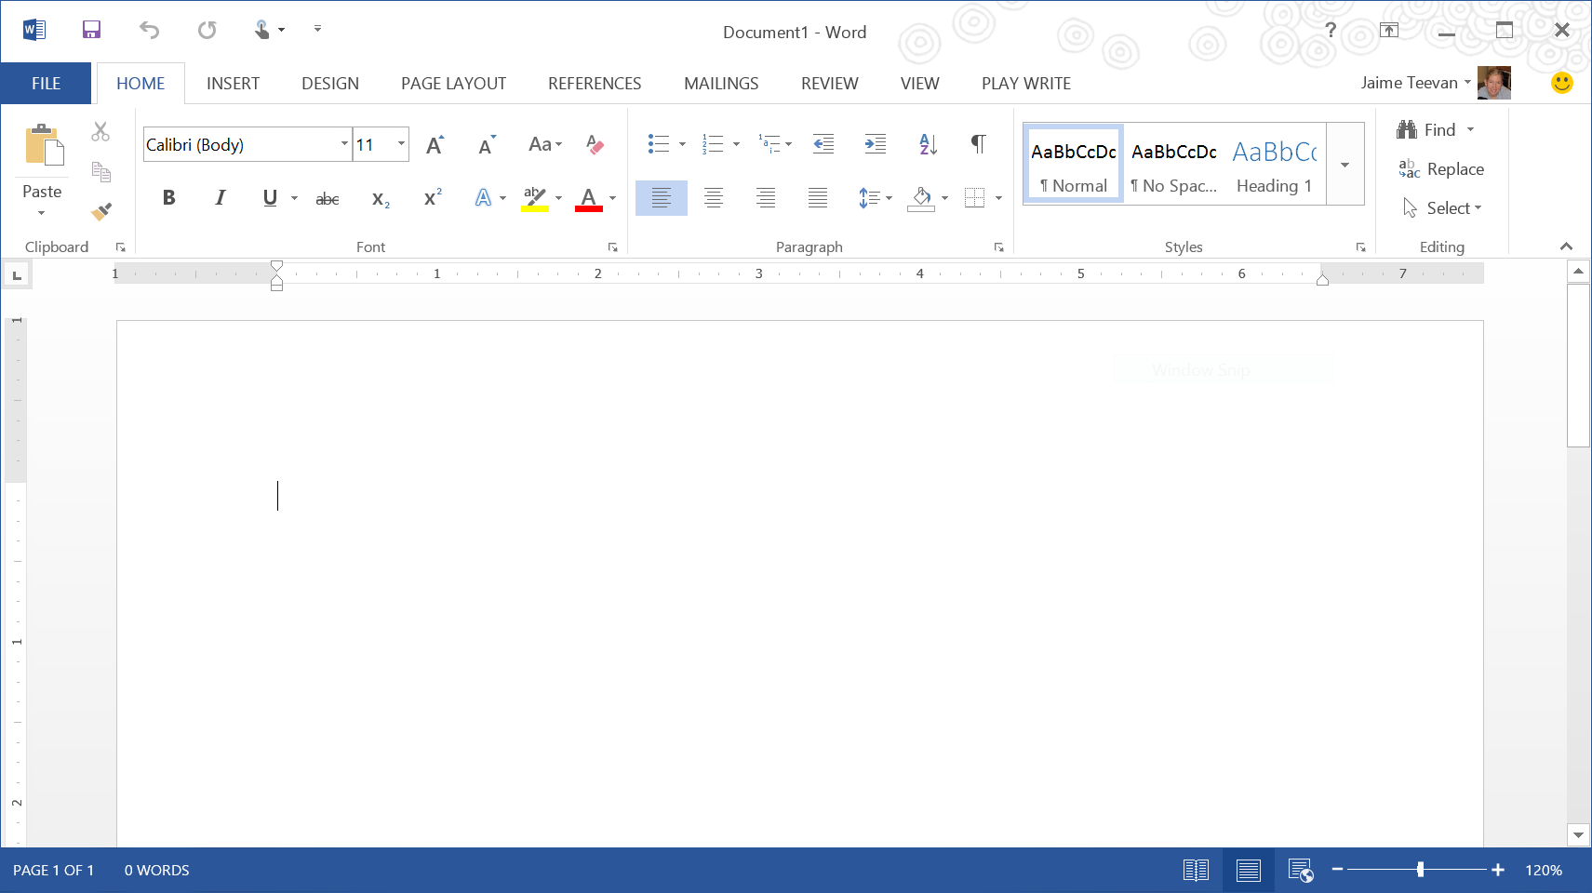
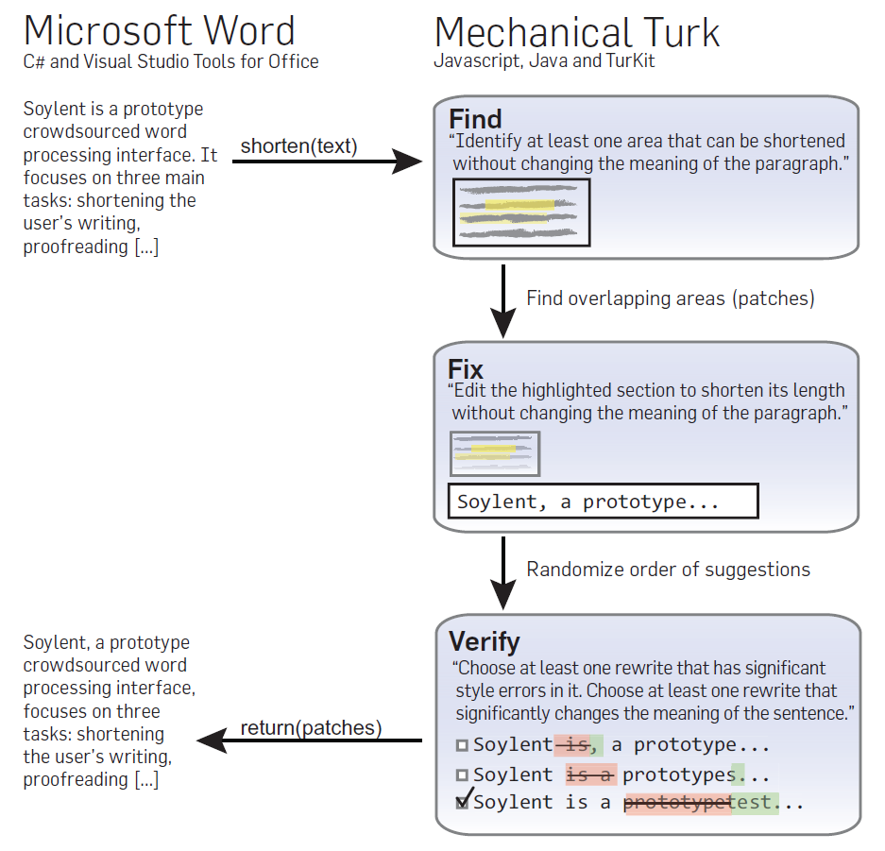
Notes:
You are probably familiar with this challenge: A blank Word document.

Slide 8
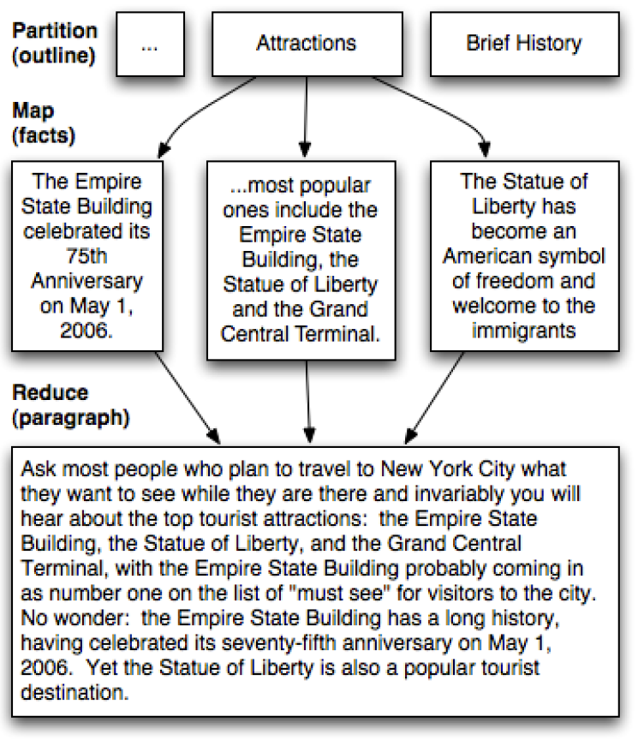
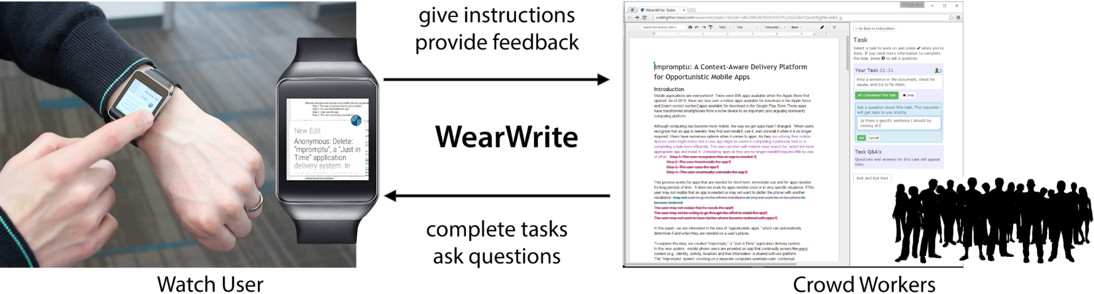
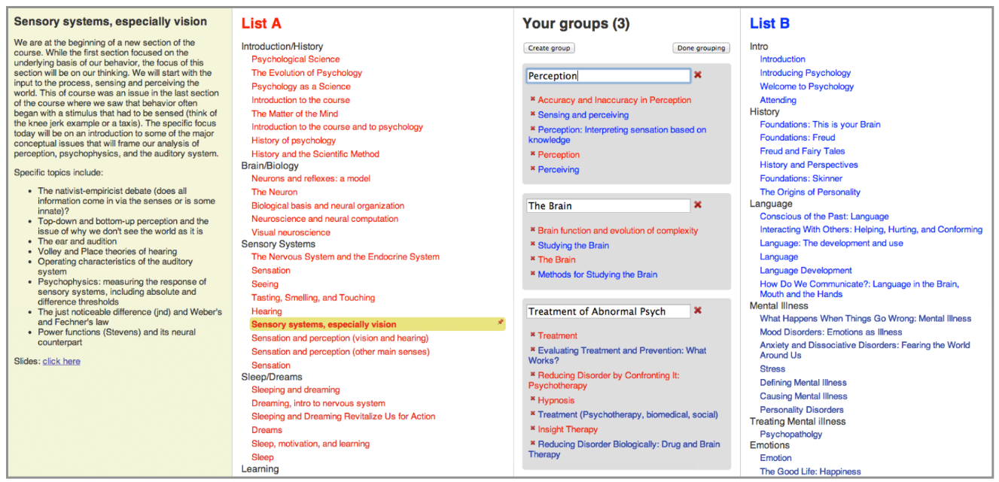
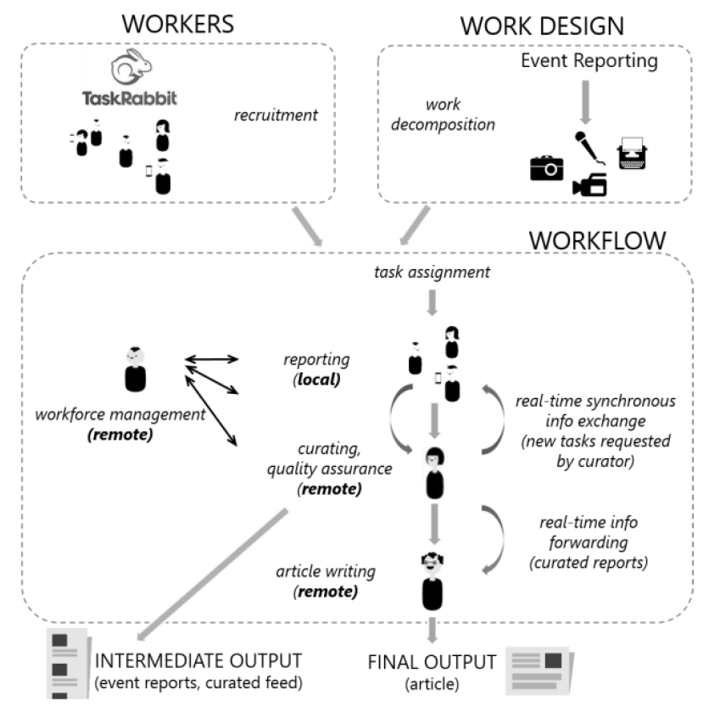
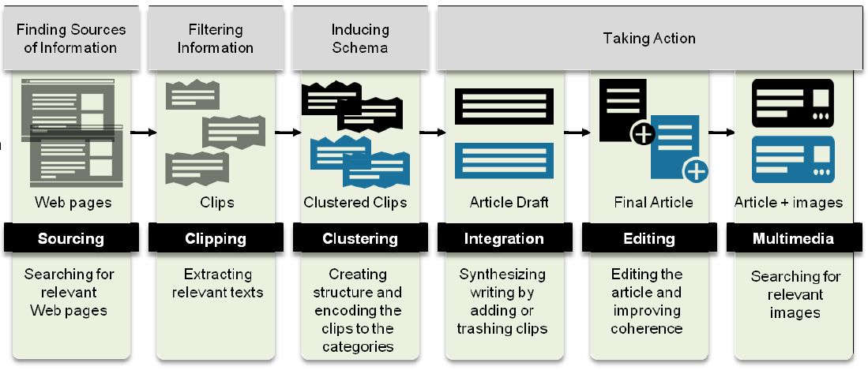
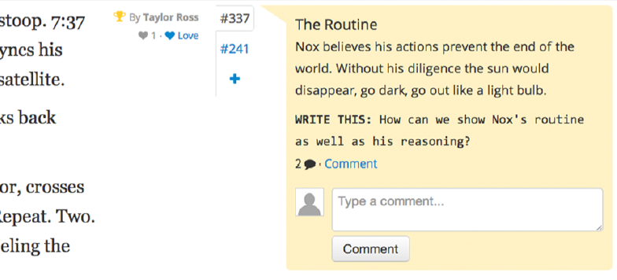
Nebeling, To, Guo, de Freitas, Teevan, Dow & Bigham. WearWrite: Crowd-assisted writing from smartwatches. CHI 2016.
Kittur, Smus, Khamkar & Kraut. CrowdForge: Crowdsourcing complex work. UIST 2011.
Luther, Hahn, Dow & Kittur. Crowdlines: Supporting Synthesis of Diverse Information Sources through Crowdsourced Outlines. HCOMP 2015.
Bernstein, Little, Miller, Hartmann, Ackerman, Karger, Crowell & Panovich. Soylent: A word processor with a crowd inside. UIST 2010.
Hahn, Chang, Kim & Kittur. The Knowledge Accelerator: Big picture thinking in small pieces. CHI 2016.
Agapie, Teevan & Monroy-Hernández. Crowdsourcing in the field: A case study using local crowds for event reporting. HCOMP 2015.
Kim, Cheng & Bernstein. Ensemble: Exploring complementary strengths of leaders and crowds in creative collaboration. CSCW 2014.

Slide 9
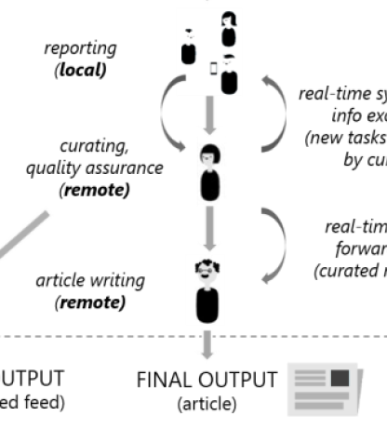
②
① Collect content
② Organize content
③ Turn content into writing
①
③
①
②
③
Notes:
Collecting content: Short data gathering tasks are useful for ideation while writing (Eventful for local event tidbits, CrowdForge for facts, Mining Memories uses tweets).

Slide 10
① Collect Content
The MicroWriter breaks writing into microtasks
Microtasks can be shared with collaborators
Microtasks can be done while mobile
Collaborative writing typically requires coordination
Collaborators can be known or crowd workers
People have spare time when mobile
Structure turns big tasks into series of small microtasks
Microtasks make it easy to get started

Slide 11
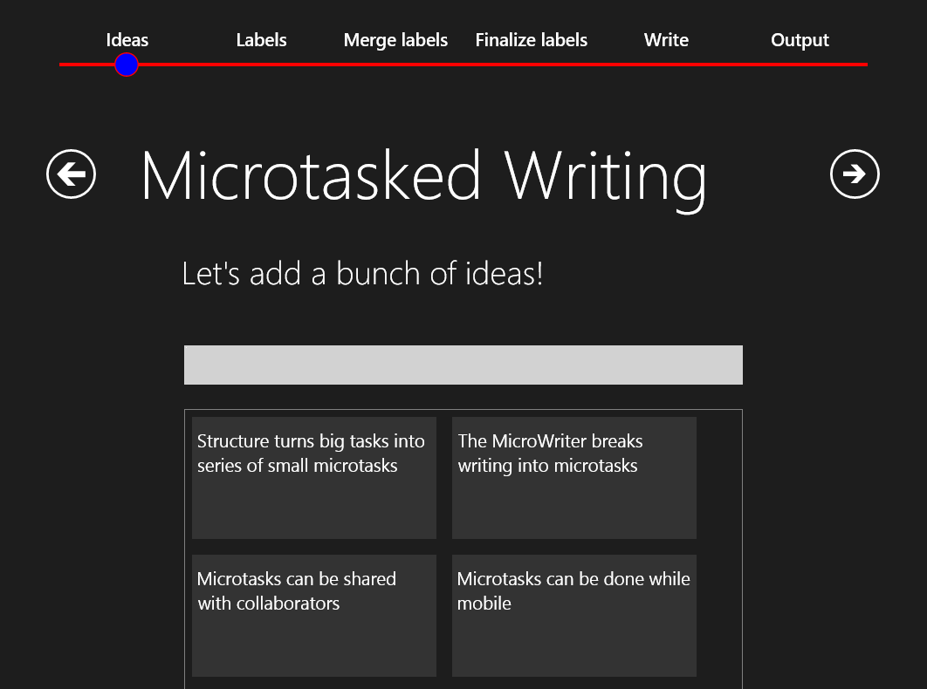
① Collect Content
Notes:
Reflect back pre-existing ideas, because these are shown to encourage brainstorming.

Slide 12

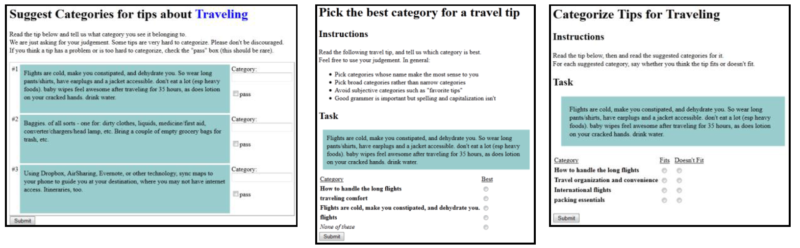
②
① Collect content
② Organize content
③ Turn content into writing
①
③
①
①
Chilton, Little, Edge, Weld & Landay. Cascade: Crowdsourcing taxonomy creation. CHI 2013.
②
③
Notes:
Organizing content: Often handled top-down and thus typically is done first (e.g., CrowdForge) or requires a “leader” with a big picture view (e.g., Ensemble). But individuals often know the content they want to write even without a structure in mind, so we allow the structure to emerge from the content inspired by the Cascade approach for organizing content into a hierarchy.

Slide 13
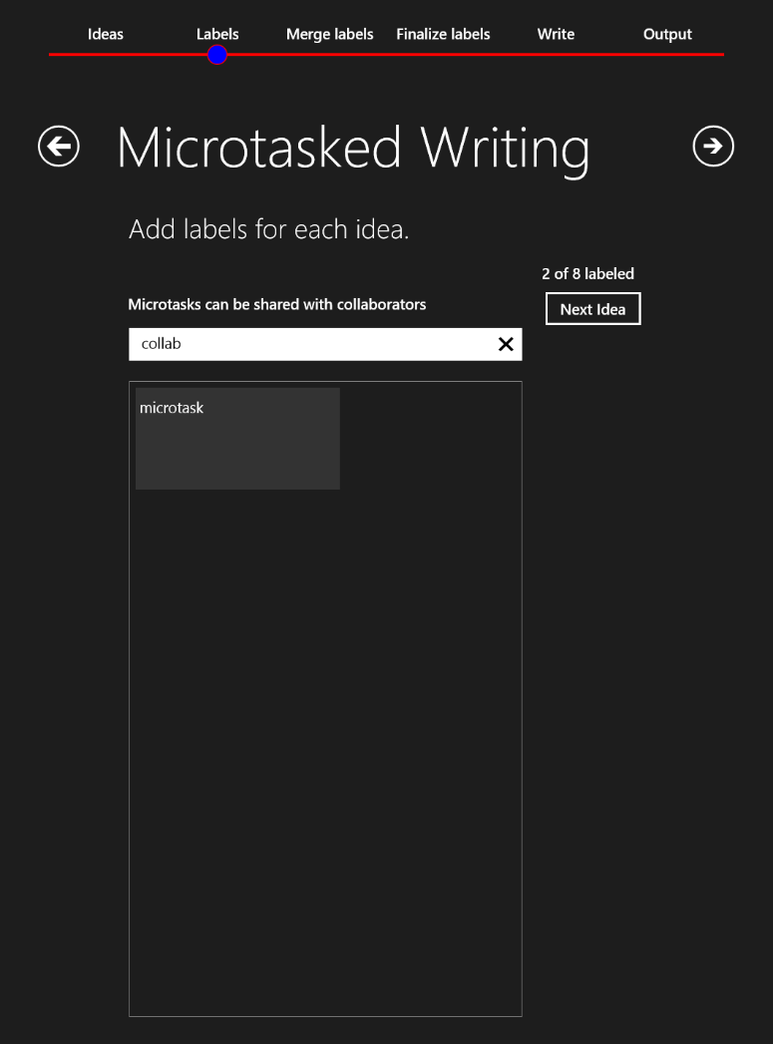
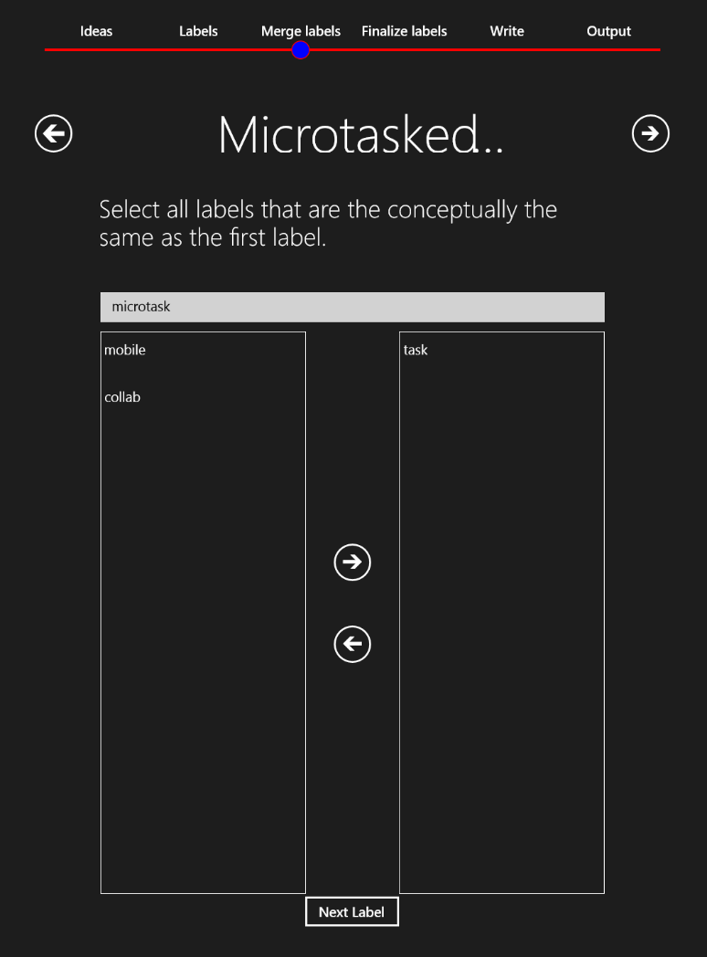
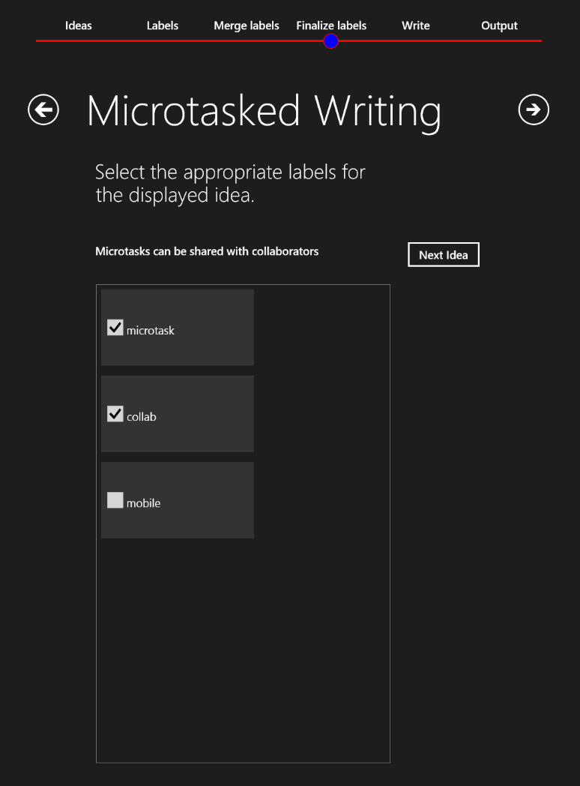

② Organize Content

Slide 14
② Organize Content
collab
Microtasks can be shared with collaborators
microtask
tasks
mobile

Slide 15
② Organize Content
The MicroWriter breaks writing into microtasks
collab
Microtasks can be shared with collaborators
Microtasks can be done while mobile
microtask
Collaborative writing typically requires coordination
mobile
Collaborators can be known or crowd workers
People have spare time when mobile
Structure turns big tasks into series of small microtasks
Microtasks make it easy to get started

Slide 16
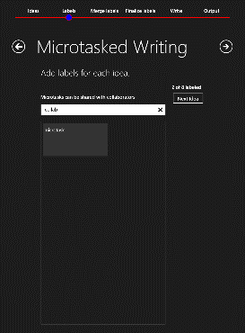
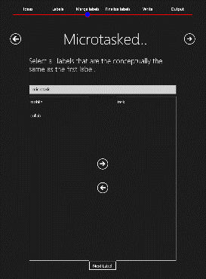
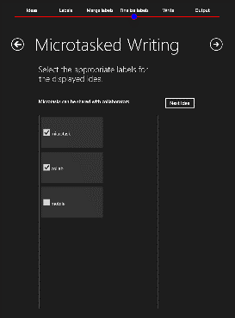

②
① Collect content
② Organize content
③ Turn content into writing
①
③
①
②
①
②
③

Slide 17
③ Turn Content into Writing
The MicroWriter breaks writing into microtasks
②
collab
Microtasks can be shared with collaborators
Microtasks can be done while mobile
①
microtask
Collaborative writing typically requires coordination
③
mobile
Collaborators can be known or crowd workers
People have spare time when mobile
Structure turns big tasks into series of small microtasks
Microtasks make it easy to get started

Slide 18
③ Turn Content into Writing
Microd
The MicroWriter breaks writing into microtasks
Structure turns big tasks into series of small microtasks
Microtasks make it easy to get started
Collab
Microtasks can be shared with collaborators
Collaborative writing typically requires coordination
Collaborators can be known or crowd workers
Mobile
Microtasks can be done while mobile
People have spare time when mobile
microtask
collab
mobile

Slide 19
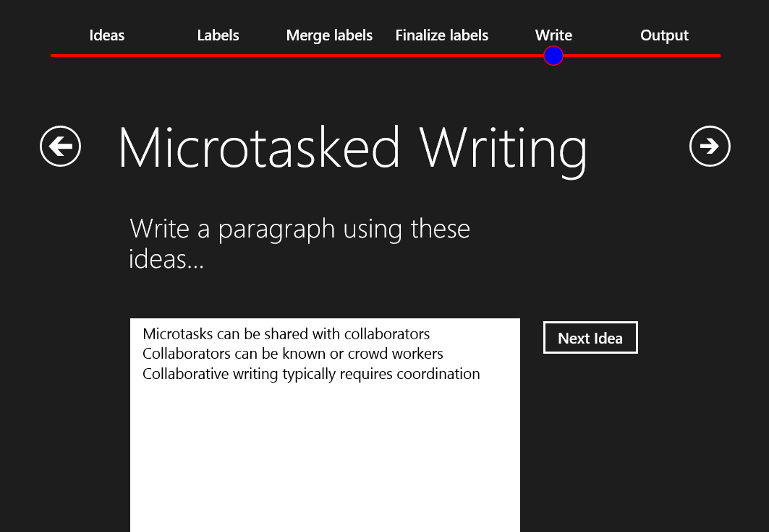
③ Turn Content into Writing

Slide 20
③ Turn Content into Writing
Micro
Microtasks can be shared with collaborators
Collaborative writing typically requires coordination
Collaborators can be known or crowd workers
collab
Collaborative writing typically requires coordination. However, microtasks are easy to share with collaborators without the need for coordination. The collaborators can be known colleagues, or paid crowd workers.

Slide 21
③ Turn Content into Writing
Complete output:
Structure makes it possible to turn big tasks into a series of smaller microtasks. For example, the MicroWriter breaks writing into microtasks. These microtasks make the larger task easier to start.
Collaborative writing typically requires coordination. However, microtasks are easy to share with collaborators without the need for coordination. The collaborators can be known colleagues, or paid crowd workers.
People have spare time when mobile, and these micromoments are ideal for doing microtasks.

Slide 22

②
① Collect content
② Organize content
③ Turn content into writing
①
③
MicroWriter
①
②
①
③
②
③
Notes:
Could then clean up the content a la Soylent.

Slide 23
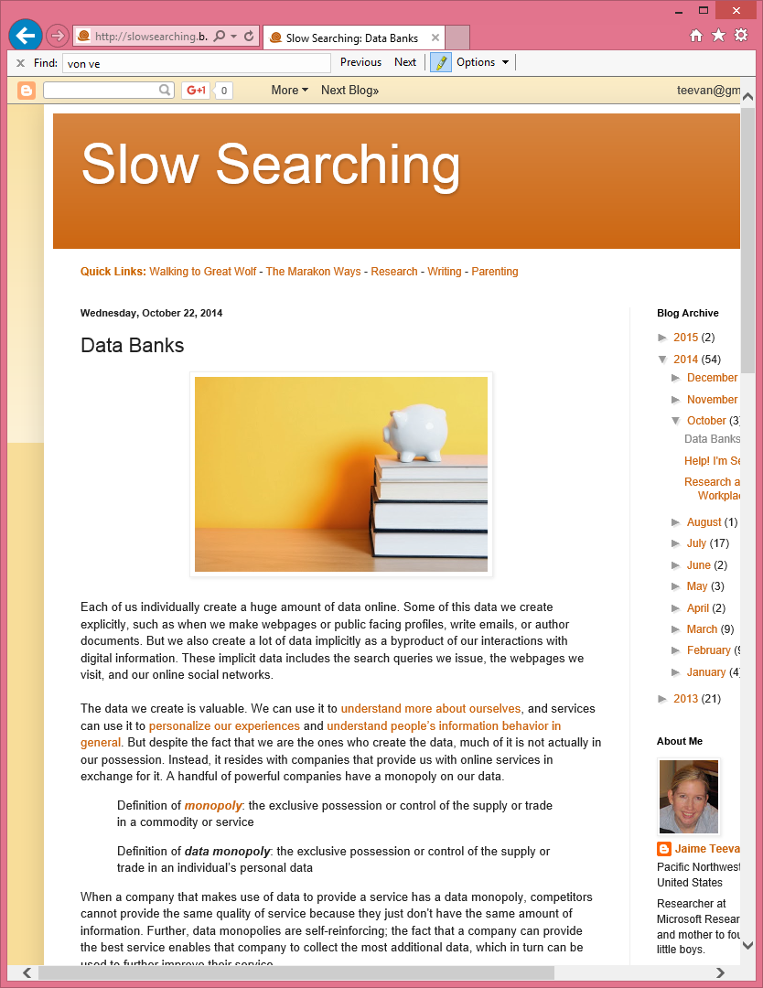
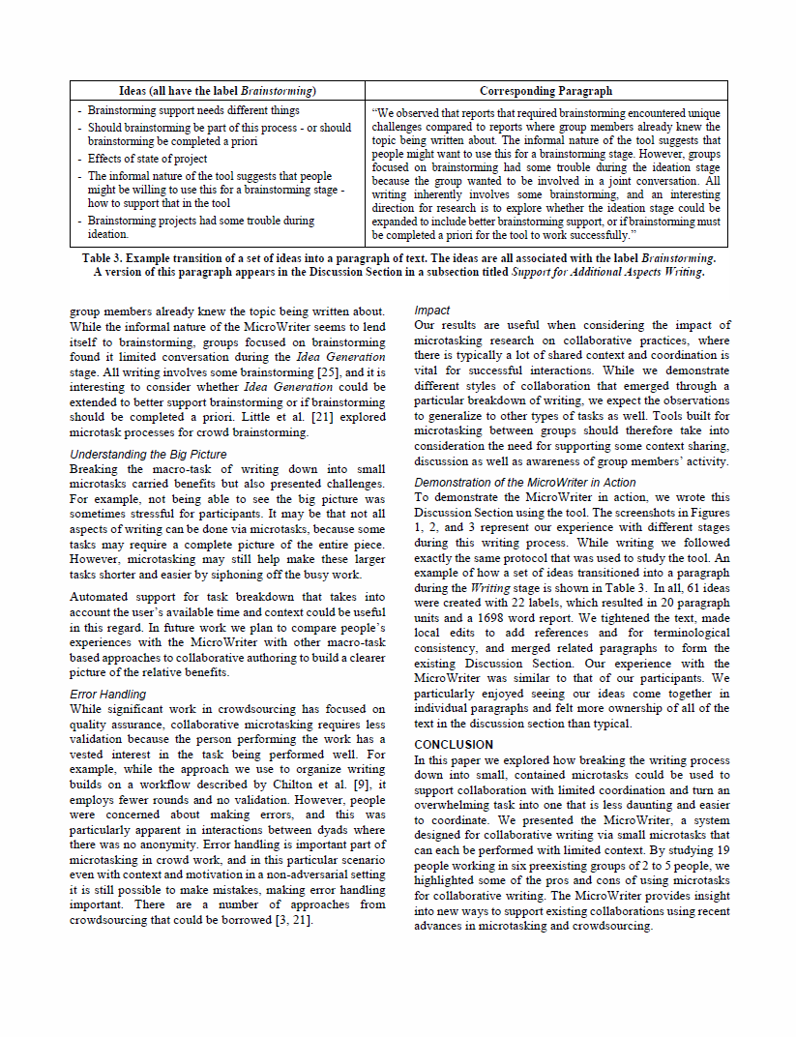

Slide 24
task completion – make it easy to do microtasks
Tasks are easier to when they are broken down into microtasks. Microtasks can be done during a person’s free mobile micromoments.

Slide 25
Studied Tasks as Macrotask or Microtasks
Macrotask
What is the total cost of all the times on the receipt?
Do not type in the dollar sign.
S M A R T Supermarket
Visit us on the Internet
Than you for shopping
K BAR
CHOCOLATE ORANGE
CADBURY SNACK
HOBNOB
SKITTLES
WALLS CORNETTO
BURTONS MARYLAND
JAFA CAKE
FRUIT SALAD
FEDDO
Type in the total.
Microtask
Microtasks
0.22
0.19
0.22
0.24
0.22
0.25
0.19
0.18
0.26
0.23
Add the cost of the next item below to the previous total.
Do not type in the dollar sign (1 of 10).
Add the cost of the next item below to the previous total.
Do not type in the dollar sign (2 of 10).
Add the cost of the next item below to the previous total.
Do not type in the dollar sign (3 of 10).
Prev Total: 0.00
Prev Total: 0.22
Prev Total: 0.41
New Item:
New Item:
+
New Item:
+
+
Total:
Total:
=
Total:
=
=
Total?
Total?
Total?

Slide 26
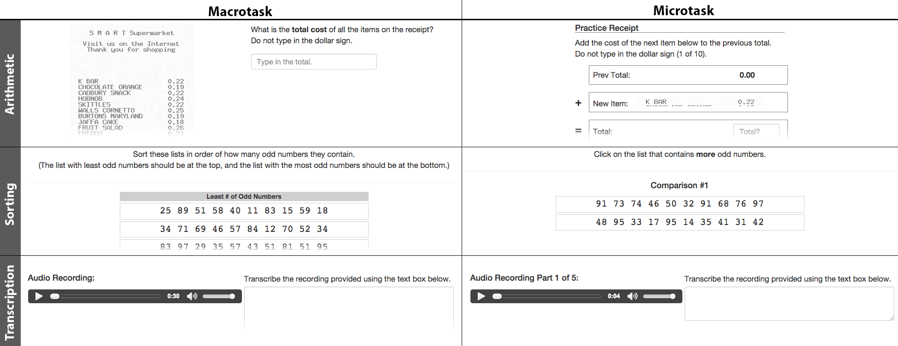
Macrotask
Microtasks
77%
Notes:
People preferred to do microtasks – 77% of the time

Slide 27
Microtasking Leads to Fewer Errors

Slide 28
Microtasking Takes Longer
What is…
69 + 79
o 149
o 168
o 147
o 148
o 138
Continue

Slide 29
Microtasking Handles Interruptions

Slide 30
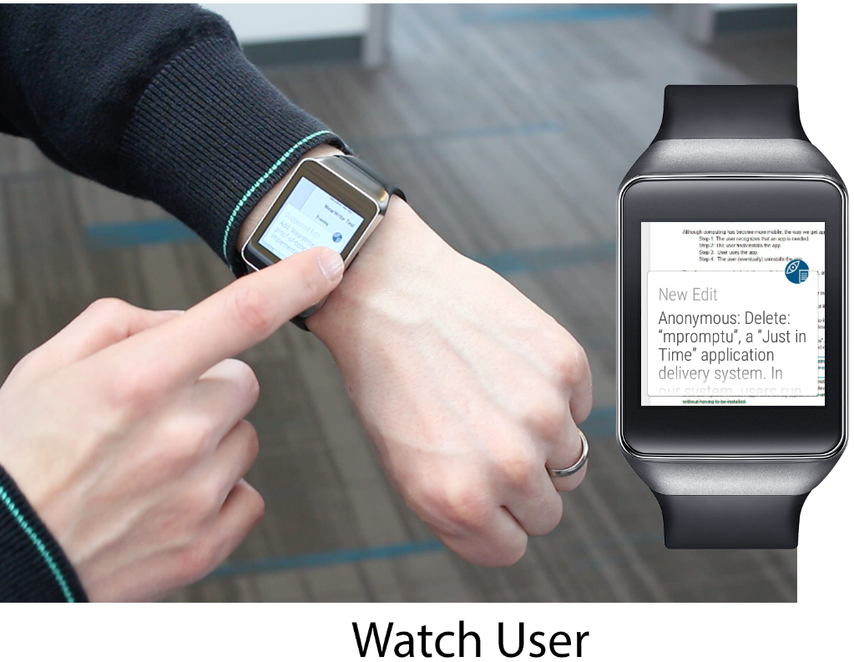
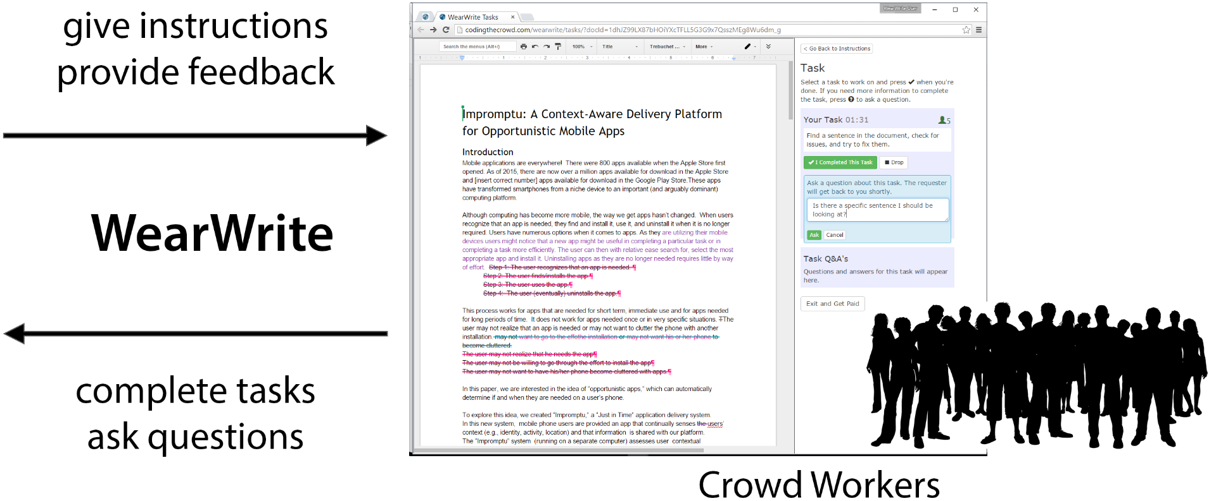
WearWrite
Notes:
WearWrite lets users orchestrate complex writing tasks through their smartwatch. The smartwatch user provides a team of crowd writers with writing tasks and feedback. The crowd writers ask clarifying questions, work on a shared Google Doc, and deliver snippets of text for review.

Slide 31
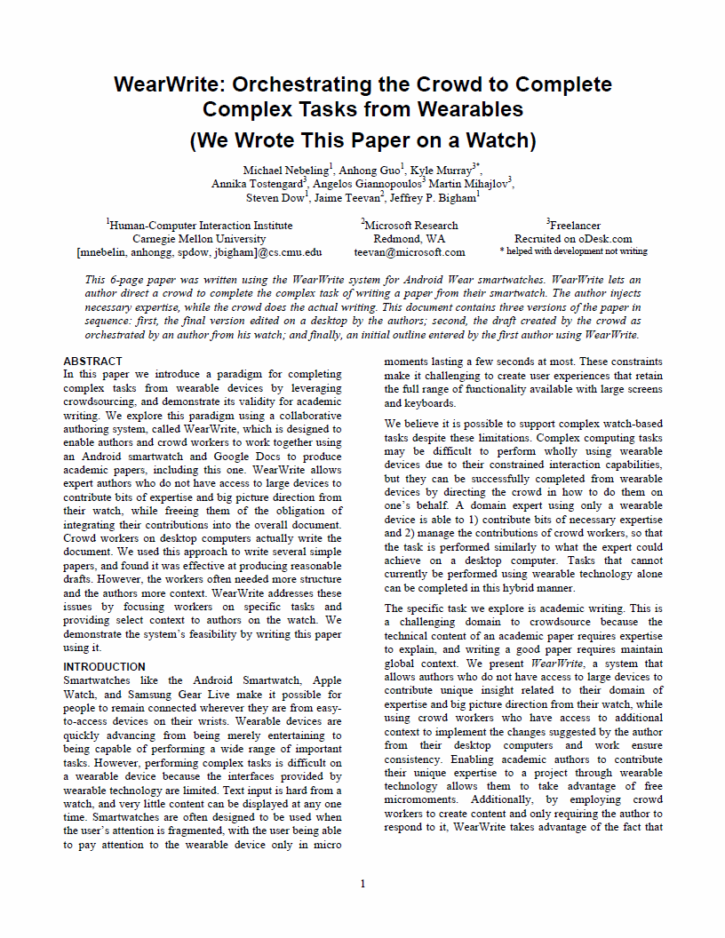

Slide 32
task sharing – get microtasks to right person
Breaking a task down reduces the overhead in collaborating with colleagues and the crowd because individual microtasks can be allocated to different people.

Slide 33
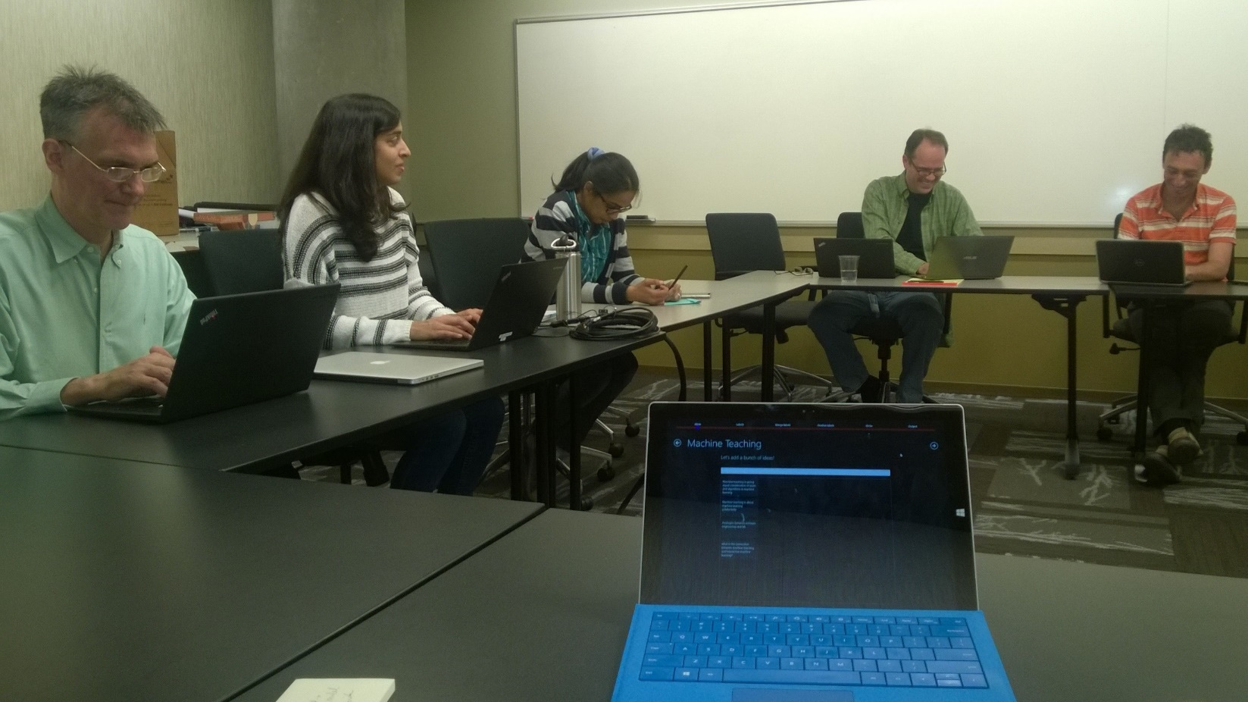
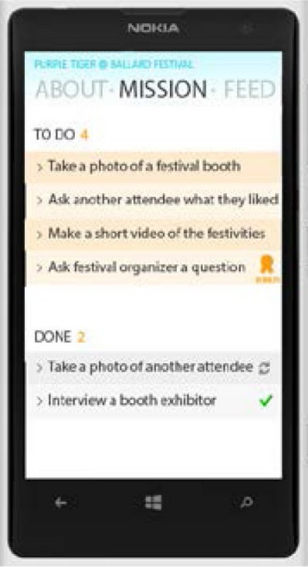
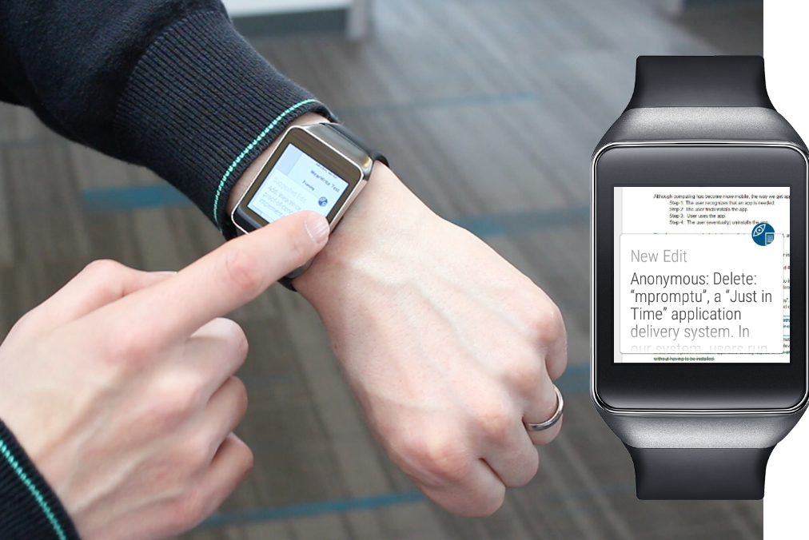
Notes:
WearWrite shares tasks with crowd workers.
We studied the MicroWriter, which I described earlier, in the context of collaboration within known work groups.
Eventful lets us allocate tasks to people who are uniquely positioned to do tasks – such as task rabbit workers at events for event reporting.
In all cases, task structure leads to low overhead, fine-grained collaboration.
Going to focus on some of the interesting aspects that come up when sharing personal productivity tasks with the crowd.

Slide 34
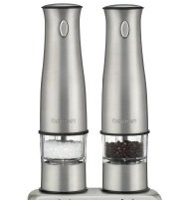
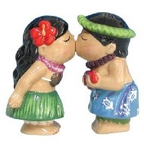
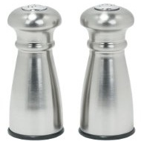
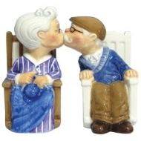
Guessing from Examples
or Rating
?
Notes:
Need to find workers who would do the task like you would
Explored several ways for doing this.
One way: “Guessing”
Show crowd workers the kind of things the searcher is interested in and ask them to guess what the user would like on other items.
Easy for the user to rate a set of example items and then use that as training for the crowd
Another way: “Rating”
Along the lines of collaborative filtering. Get worker to do the same work the user did, and find the best match.
Organisciak, Teevan, Dumais, Miller, Kalai. A crowd of your own: Crowdsourcing for on-demand personalization. HCOMP 2014.

Slide 35
Asking the Crowd to Guess v. Rate
 | Base | Guess | Rate
Salt shakers | 1.64 | 1.07 | 1.43
Food (Boston) | 1.51 | 1.38 | 1.19
Food (Seattle) | 1.68 | 1.28 | 1.26
 | 1.64 | 1.07 | 1.43
 | 1.51 | 1.38 | 1.19
 | 1.68 | 1.28 | 1.26
Guessing
Requires fewer workers
Fun for workers
Hard to capture complex preferences
Rating
Requires many workers to find a good match
Easy for workers
Data reusable
Notes:
Both: Target tail areas, personal data, areas where we don’t have a lot of collaborative data
(RMSE for 5 workers)
Results shown for 5 workers
10 workers did much better for taste-matching.
Didn’t make as much of a difference for guessing.

Slide 36
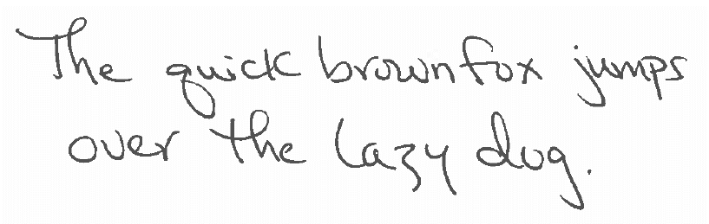
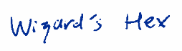
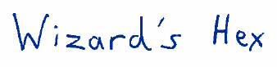
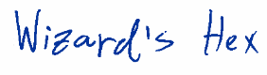
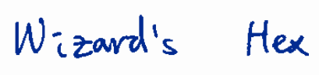
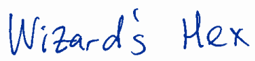
Handwriting Imitation
via Rating
Task: Write “Wizard’s Hex”
Notes:
Random person: 17% of the time thought a match
Actual person: 83% of the time thought a match
13 people required to find someone who will be mistaken for a match 50% of the time
--
Cool thing is this approach can be applied to tasks beyond what we currently handle algorithmically.
For example: Handwriting Imitation
Figure shows requester’s text: The quick brown fox jumps over the lazy dog
And a variety of people writing: Wizard’s Hex
Includes an example by the requester, some random examples, and ones that attempt to imitate the requester
Collaborative filtering approach: Takes a lot of people to do reasonably!
There are some people out there who have handwriting that is similar to yours, but not that many.
Having a random person write the term is pretty bad – only mistaken for the requester 17% of the time
The requester’s not that great, either – discovered as the requester 83%
13 people to find someone who will be mistaken for the requester 50% of the time

Slide 37
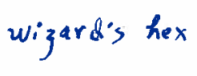
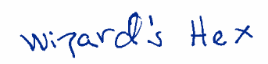

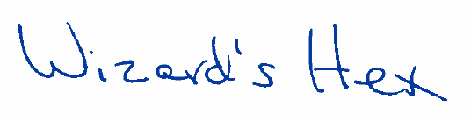
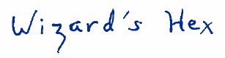
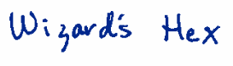
Handwriting Imitation
via Guessing
Task: Write “Wizard’s Hex” by imitating this handwriting
Notes:
Guessing: Pretty good approximation (over 50%) with just 5 people.
This picture shows 5 “guessed” versions of the text, and 1 that is actually the requester.
Can you guess which is the true version?

Slide 38
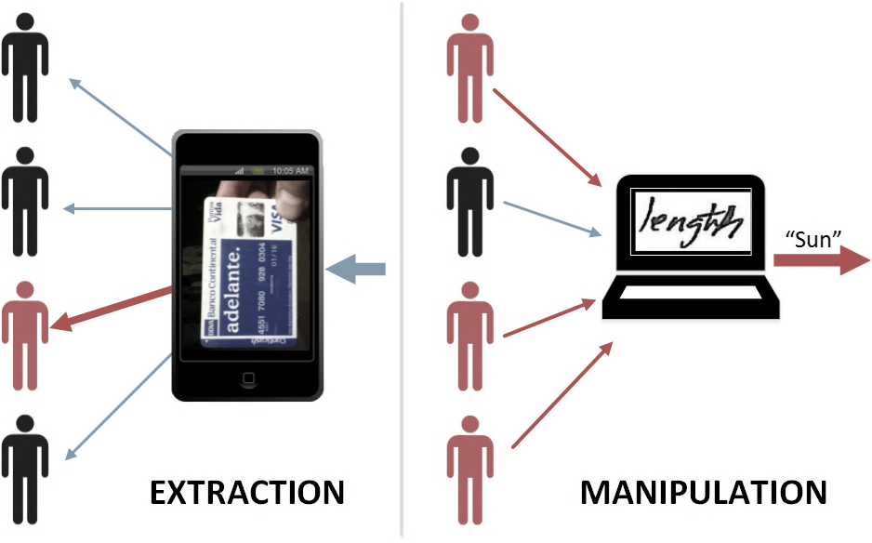
Extraction and Manipulation Threats
Notes:
Describe extraction and manipulation risks
We want to learn: What is the risk of the crowd being used in a coordinated manner to force a system to come up with the wrong outcome?
Lasecki, Teevan, Kamar. Information extraction and manipulation threats in crowd-powered systems. CSCW 2014.

Slide 39
Task Extraction
Target task – Text recognition
Attack task
Complete target task
Return answer from target:
1234 5678 9123 4567
62.1%
32.8%
1234 5678 9123 4567

Slide 40
Task Manipulation
Target task – Text recognition
Attack task
Enter “sun” as the answer for the attack task
gun (36%), fun (26%), sun (12%)
sun (75%)
sun (28%)
Notes:
What do you think this says?
Crowd workers asked to do the target task say:
Gun: 36%
Fun: 26% (actually is fun)
Sun: 12%
When the attack task asks workers to input “sun” we get many more instances of “sun”
The workers don’t feel like what they are doing is particularly bad, so we are able to influence behavior
However, when they are shown the word “length” instead, they are much less likely to enter “sun”
Seems there is a base rate of roughly 1 in 3 crowd workers appear willing to do questionable things regardless.
Be it extraction or manipulation
And about a third can be manipulated by making the attack task seem less questionable (e.g., plausible input, fake credit card v. real one)

Slide 41
Impact of Payment
Target $0.05
Target $0.05
Target $0.25
Notes:
Interestingly, this middle third can also be manipulated by paying them more
Paying $.50 instead of $.05 doubles the number of attackers
That third that won’t enter the realistic looking credit card number?
They’ll do it for an extra 45 cents.
Target tasks can fight back by paying more or asking people not to attack them.
Pay more to do the target task ($.25): The base 32% will still attack, but the conditional attackers won’t.
Bad news: Some people willing to take advantage of the information they see during crowd work for financial gain
Good news: Some people pass on additional money to do “the right thing”
There may be ways to use the “good” workers to identify “bad” workers
Currently thinking about approaches that use an “ethical gold” to identify good workers and help them police negative behavior.

Slide 42
Summary of Microproductivity
Task Structure – Break tasks into microtasks
What we know: Examples of many complex tasks can be broken down
Still needed: What tasks can be broken down? How to capture context?
Task Completion – Make it easy to do microtasks
What we know: Microtasking is easier, especially when mobile
Still needed: When to break tasks down? How to prioritize microtasks?
Task Sharing – Get microtasks to the right person
What we know: Reduce collaboration overhead with colleagues, crowd
Still needed: Who is the best person to do a microtask?
Task Automation – Learn microtasks via hybrid intelligence
What we know: Possible to incorporate automation into workflows
Still needed: When can AI systems benefit from human input?

Slide 43
Learn More about Microproductivity
Overview
Teevan, Libeling, Lasecki. Selfsourcing personal tasks. CHI 2014.
Teevan. The future of microwork. XRDS, 2016.
Teevan, Iqbal, Cai, Bigham, Bernstein, Gerber. Productivity decomposed: Getting big things done with little microtasks. CHI 2016.
Greer, Teevan, Iqbal. An introduction to technological support for writing. MSR-TR-2016-01, 2016.
Task Structure
Cheng, Teevan, Iqbal, Bernstein. Break it down: A comparison of macro- and microtasks. CHI 2015.
Teevan, Iqbal, von Veh. Supporting collaborative writing with microtasks. CHI 2016.
Task Completion
Nebeling, To, Guo, de Freitas, Teevan, Dow, Bigham. WearWrite: Crowd-assisted writing from smartwatches. CHI 2016.
Cai, Iqbal, Teevan. Chain reactions: The impact of order on microtask chains. CHI 2016.
Task Sharing
Agapie, Teevan, Monroy-Hernández. Crowdsourcing in the field: A case study using local crowds for event reporting. HCOMP 2015.
Salehi, Teevan, Iqbal, Kamar. Communicating context to the crowd for complex writing tasks. CSCW 2017.
Lasecki, Teevan, Kamar. Information extraction and manipulation threats in crowd-powered systems. CSCW 2014.
Organisciak, Teevan, Dumais, Miller, Kalai. A crowd of your own: Crowdsourcing for on-demand personalization. HCOMP 2014.
Task Automation
Toutanova, Brockett, Tran, Amershi. A dataset and evaluation metrics for abstractive sentence and paragraph compression. EMNLP 2016.
Kamar, Hacker, Horvitz. Combining human and machine intelligence in large-scale crowdsourcing. AAMAS 2012.

